Slide 1
A model/data comparison success story in the Gulf of Maine
Rich Signell (USGS)
Ellyn Montgomery (USGS)
Changsheng Chen (UMASS/SMAST)
The International Geoscience Community

Slide 2
Assessing a 30 year ocean hindcast in the Gulf of Maine
One 15 TB dataset from 4D ocean model served via the THREDDS data server at UMASS/SMAST
600 time series datasets from 3 different THREDDS catalogs (USGS, NOAA/NMFS, WHOI) (Ellyn will talk more about this)

Slide 3
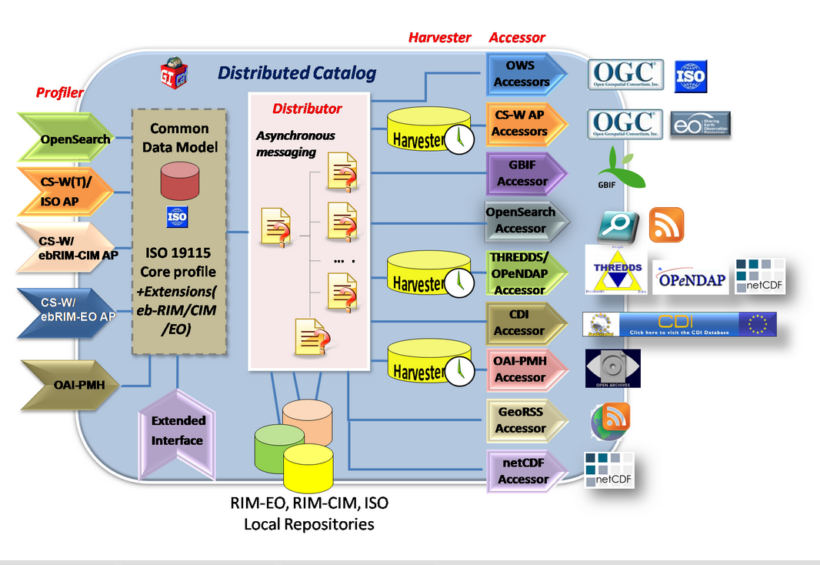
GI-CAT catalog broker service

Slide 4
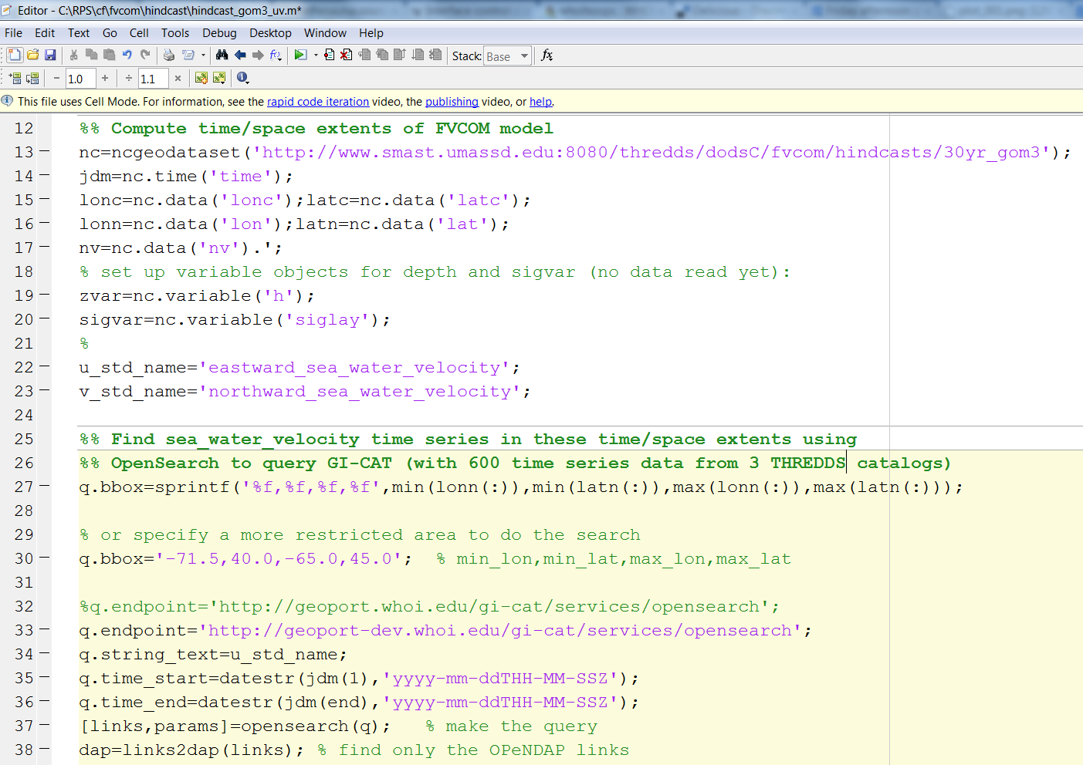

Slide 5
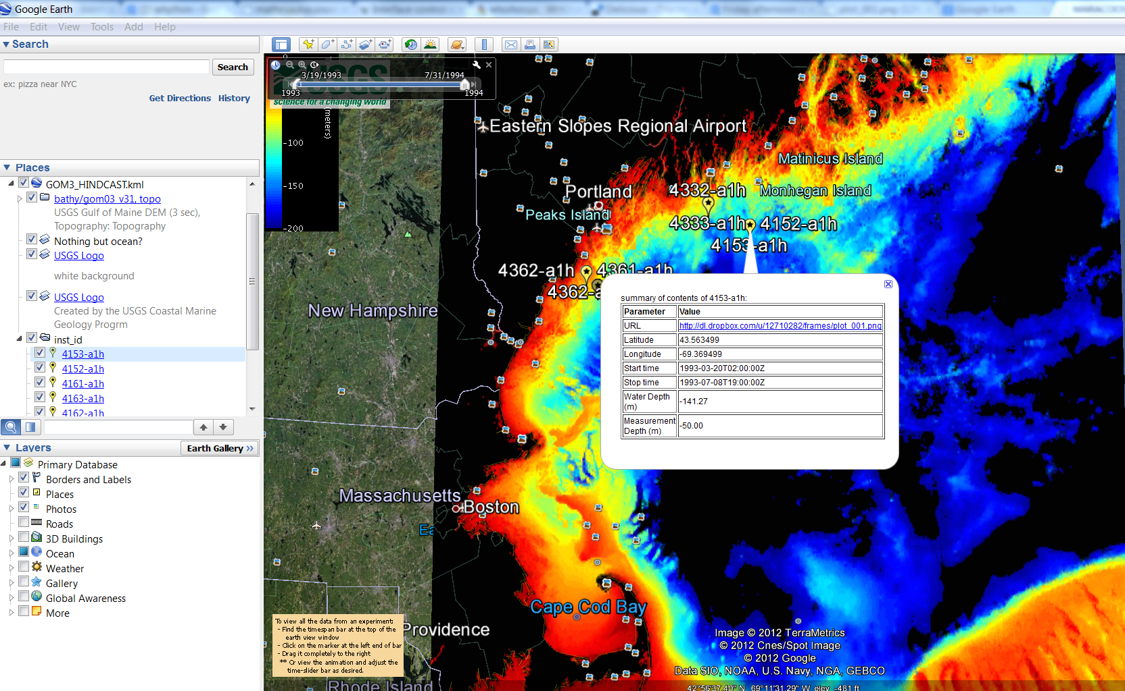

Slide 6
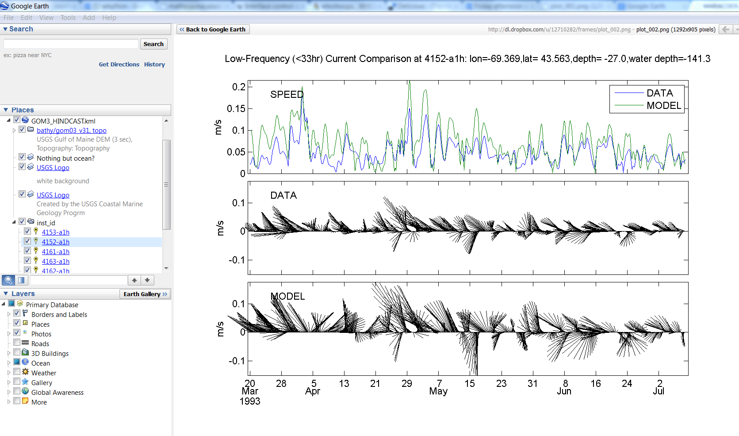

Slide 7
