Slide 1
Ocean Tracking Network
NERACOOS/NECOSP Data Management Workshop, Sept. 26, 2012
Bob Branton,
Lenore Bajona, Susan Dufault, Brian Jones, Marta Mihoff
Dalhousie University, Halifax Canada
Global.OceanTrack.org

Slide 2
Goals of the Program
Union of physical oceanographers and animal trackers on global scale
Research Themes
Data Management
Biology and behavior of migrating marine life
Ocean physics modeling
Impact of ocean climate on the first two
Resource management
International social and legal framework for the oceans
Since March 2010, OTN has acquired 28 million records
on 40 species from 162 projects in 14 countries.
Notes:
Use this slide to present an overview of your organization’s or the specific data program you are presenting on
This slide could include goals of the program
Describe who the data consumers are e.g. internal and/or external?
Include any fed, state or other data management requirements you have

Slide 3
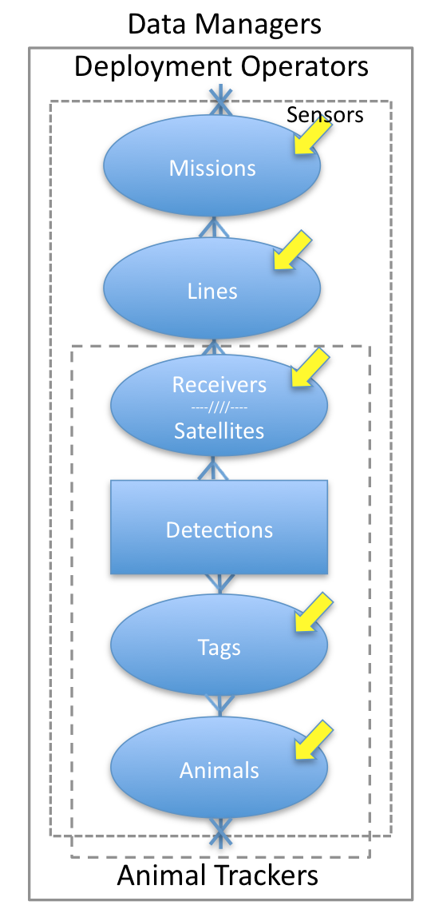
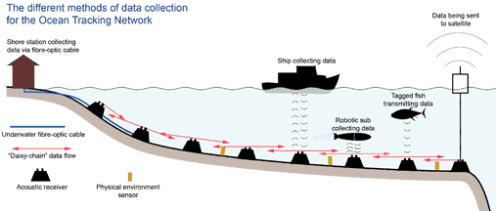
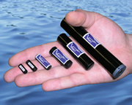
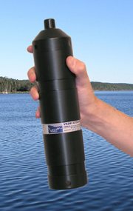
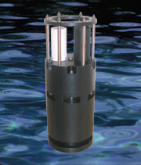
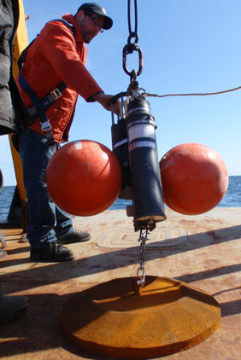
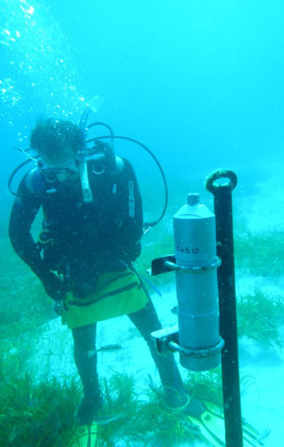
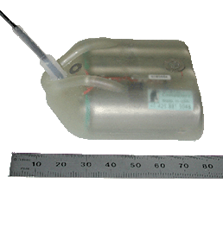
About our data
Satellites
Global.OceanTrack.org/about/ocean
acoustic tags¹
acoustic receivers¹
acoustic mooring assemblies²
satellite tags³
Photo Credits: ¹www.vemco.com ²Global.OceanTrack.org/galleries ³www.wildlifecomputers.com
Notes:
Use this slide to describe the data types managed and shared. Describe the data, how often it is updated, is it an ongoing program how long has it been going etc.
3

Slide 4
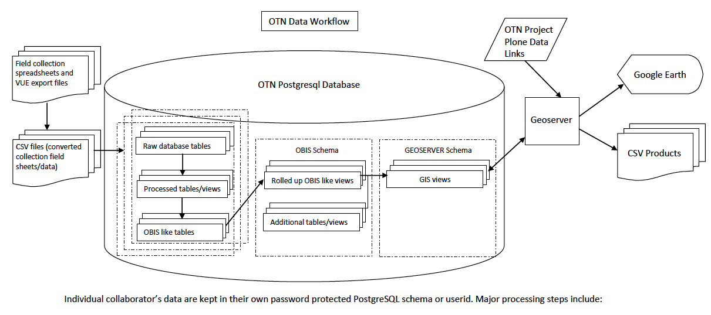
Managing our data
Secure Data Warehouse and Workflow
Collaborator’s data are stored in a separate schema (userid) within the OTN open source database. OTN Collaborators can be either Deployment Collaborator, Tracker Collaborator, or Data Collaborator. Software used includes: RedHat Linux, PLONE CMS, PostgreSQL PostGIS, GeoServer, R and RStudio.
Notes:
Use this slide to describe how the data is stored and archived e.g. relational database, file system, etc.
Indicate if you have meta data and what standard is used e.g. FGDC, GCMD etc.
describe tools and/or access points that are available for others to get this data e.g. web services, ability to get CSV file etc.

Slide 5
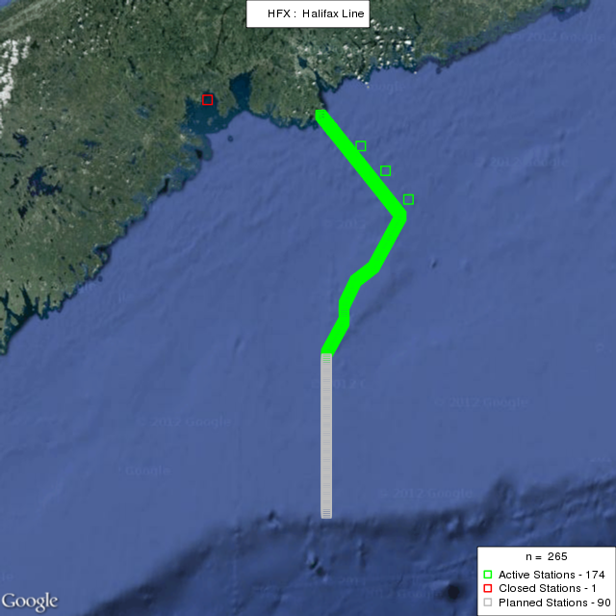
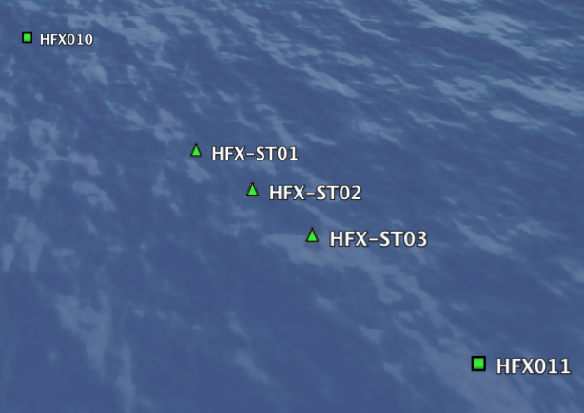
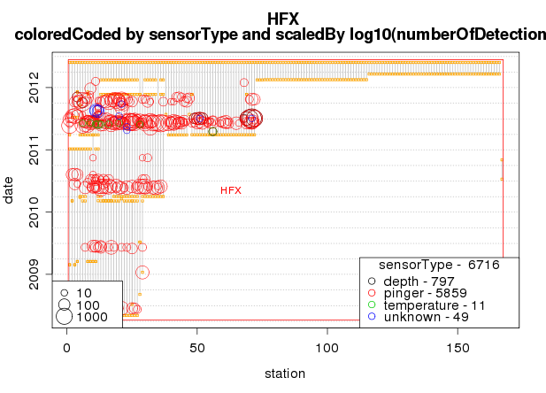
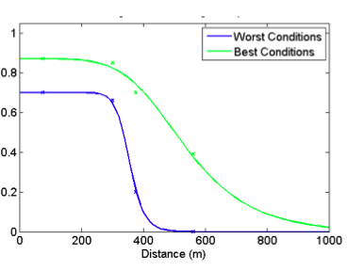
Quality Assurance
a) Mystery Tags: tags and sensors without release metadata and or calibrations
b) Duplicate IDs: more than one tag or sensor with same ID
d) Performance
c) Coverage
(87 transmitters at 11 locations)

Slide 6
Successes
Acceptance by IOOS POST-NANOOS Project as
data management template for US Animal Acoustic Telemetry (AAT) Data.
Notes:
6
Describe what has worked well and what you would recommend to other data managers who are working with similar data
Show or describe an example of how this data is used internally or by other organizations in research, decision making, policy development etc.

Slide 7
Challenges
http://www.oecd-ilibrary.org/science-and-technology/oecd-principles-and-guidelines-for-access-to-research-data-from-public-funding_9789264034020-en-fr
Communicating with data archives and other data producing institutions.
Getting essential organization and curation of data acknowledged in the funding process.
Determining extent to which publications are generated from the reuse of data.
Notes:
Use this slide to describe your major data management challenges e.g. no meta data, no archival, restrictions on access etc. and if possibly describe why it’s a challenge e.g. lack of staff time or lack of appropriate standard

Slide 8
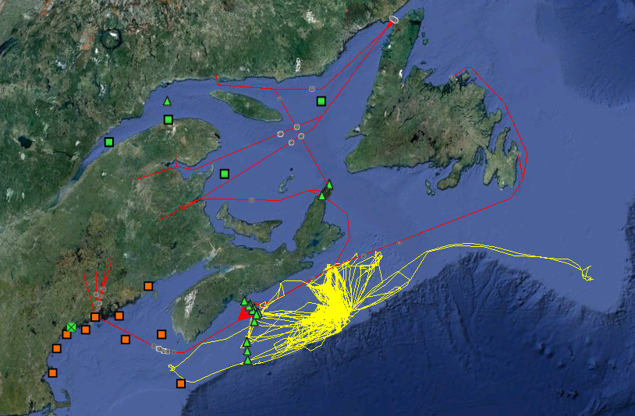
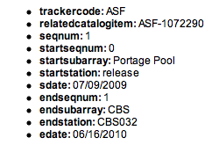
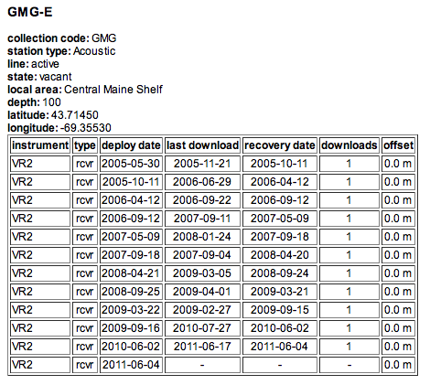
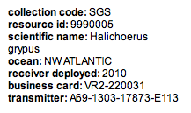
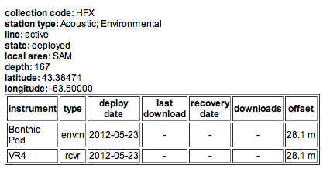
Take Home Points
Authoritative, discoverable, accessible and interoperable research data on local, regional and global scales, for example…
Not shown are OTN’s Slocum and Liquid Robitics glider missions.
GSL buoys
Atlantic salmon
gray seals
GoM buoys
Benthic Pods
http://global.oceantrack.org
Bob.Branton@dal.ca
Notes:
Use this slide if needed to summarize the major take home points
Also use this slide to show your contact info and links to more info about what you do

